Slide 1
IBM Data Analyst Capstone Project
Arjay Aquino
Github: https://github.com/h4rshjo/Dashboard-Cognos
05/19/24

Slide 2
Current Technology Usage Dashboard
Top 10 Languages:
JavaScript is the most used language among respondents, followed by HTML/CSS and SQL.
JavaScript leads with 8687 respondents, significantly ahead of the second-place HTML/CSS with 7830 respondents.
C++ is the least among the top 10 with 1946 respondents.
Top 10 Databases:
MySQL is the most popular database, with Microsoft SQL Server and PostgreSQL following closely.
MySQL has 5469 respondents using it, indicating its strong presence in the database landscape.
Firebase rounds out the top 10 with 1314 respondents.
Platforms:
The word cloud reveals Linux, Docker, and Windows as the most frequently mentioned platforms.
Linux and Windows dominate, indicating their widespread use in various development environments.
Top 10 Web Frameworks:
jQuery is the most used web framework, followed by Angular/Angular.js and React.js.
jQuery has 3345 respondents, showing its enduring popularity despite newer frameworks.

Slide 3
Future Technology Trends Dashboard
Top 10 Languages Desired for the Next Year:
JavaScript remains the top desired language, followed by HTML/CSS and Python.
JavaScript has 6630 respondents desiring to learn it, indicating its continued relevance and demand.
Top 10 Databases Desired for the Next Year:
PostgreSQL is the most desired database, followed by MongoDB and Redis.
PostgreSQL has 4328 respondents desiring to use it, reflecting its growing popularity.
Desired Platforms for the Next Year:
AWS, Docker, and Linux are the most desired platforms.
The tree map visualization shows a diverse range of platforms that respondents are interested in, including cloud platforms and development environments.
Top 10 Web Frameworks Desired for the Next Year:
React.js is the most desired web framework, followed by Vue.js and Angular/Angular.js.
React.js leads with 3655 respondents, highlighting its strong position in future technology trends.

Slide 4
Demographics Dashboard
Respondent Count by Gender:
The majority of respondents identify as Man (93.4%), with Woman respondents at 6.6%.
The pie chart clearly indicates a significant gender imbalance among the respondents.
Respondent Count for Countries:
The map chart shows a global distribution of respondents, with high concentrations in the United States, India, and Germany.
The map highlights the diverse geographical representation in the survey.
Respondent Count by Age:
The line chart shows a peak in respondents in their late 20s and early 30s, with the highest count at age 28.
The respondent count decreases steadily with age, showing a younger demographic is more represented.
Respondent Count by Gender and Education Level:
The stacked bar chart shows that the majority of respondents have a Bachelor's degree, followed by Master's degree holders.
Men significantly outnumber Women across all education levels, highlighting the gender disparity in tech education.

Slide 5
Introduction
Purpose: This report provides a comprehensive analysis of the current and future technology usage trends, based on the Stack Overflow Developer Survey 2019 data. It includes insights into the most popular programming languages, databases, platforms, and web frameworks, as well as demographic information about the respondents.
Audience: The report is intended for stakeholders in the technology industry, including developers, technology managers, educators, and policymakers. It is also useful for anyone interested in understanding the trends and demographics of the global developer community.
Benefits: By reading through this report, readers will gain valuable insights into:
The most widely used and desired programming languages, databases, platforms, and web frameworks.
Future technology trends and the evolving preferences of developers.
Demographic patterns within the developer community, including gender, geographical distribution, age, and educational background.
Data-driven information to help guide decision-making in technology adoption, education, and workforce development.

Slide 6
Methodology
Data Sources: The data for this report was sourced from the Stack Overflow Developer Survey 2019, a comprehensive survey conducted by Stack Overflow.
Data Collection: The survey was conducted online, targeting a wide range of respondents from the global developer community. Participants voluntarily provided information about their technology usage, preferences, and demographics.
Data Processing: The collected data was cleaned and normalized for analysis. Two primary datasets were used:
Technologies Dataset: This dataset includes information on the current and desired programming languages, databases, platforms, and web frameworks used by respondents.
Demographics Dataset: This dataset provides demographic information, including gender, country of residence, age, and education level.
Visualization: Data visualizations were created using Python libraries such as Pandas, Matplotlib, Seaborn, WordCloud, and Geopandas. These visualizations include bar charts, column charts, pie charts, line charts, word clouds, tree maps, and map charts to effectively communicate the insights derived from the data.

Slide 7
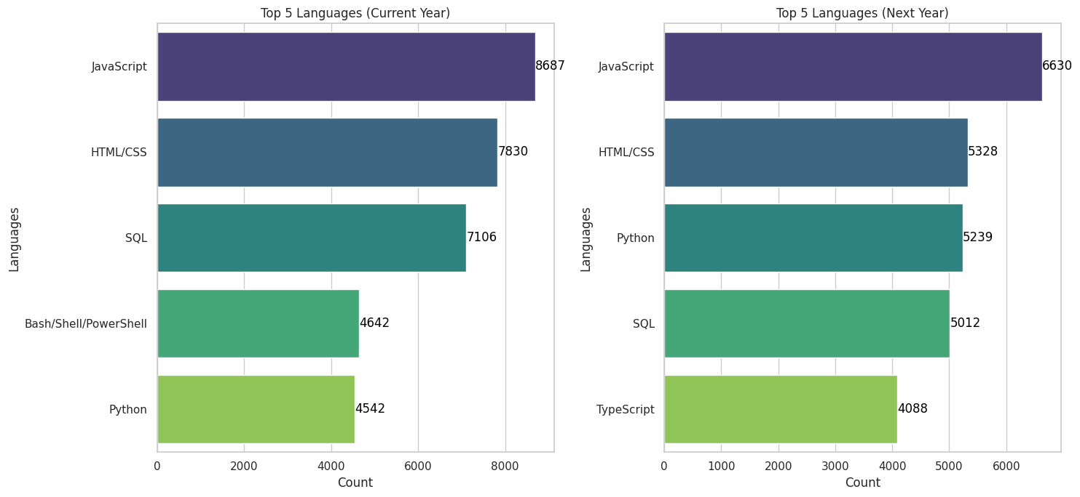
top 5 programming languages for current year and future year

Slide 8
Programming Languages Trends - Findings and Implications
In the current year, JavaScript, HTML/CSS, SQL, Python, and Java are the top programming languages, reflecting their essential roles in web development, data manipulation, and enterprise applications. For the future year, JavaScript, HTML/CSS, Python, SQL, and TypeScript are the most desired languages, with Python and TypeScript showing significant growth in interest.
Implications: Developers proficient in JavaScript and Python will remain in high demand, particularly in web development and data science roles. The continued importance of HTML/CSS underscores the need for strong front-end skills, while SQL's relevance highlights the demand for data management expertise. The rising interest in TypeScript indicates a shift towards more robust JavaScript development practices. Educational institutions and training programs should emphasize these languages to align with industry needs, ensuring developers are equipped with the skills most sought after in the job market.

Slide 9
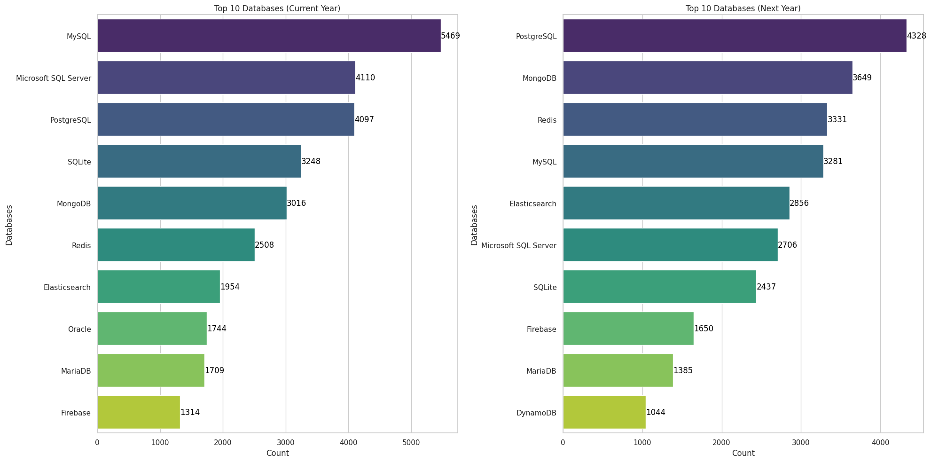
top 5 programming languages for current year and future year

Slide 10
Database Trends - Findings and Implications
In the current year, MySQL, Microsoft SQL Server, PostgreSQL, SQLite, and MongoDB are the top databases, reflecting their reliability and widespread use. For the future year, PostgreSQL, MongoDB, Redis, MySQL, and Elasticsearch are the most desired databases, highlighting a growing interest in both traditional and NoSQL databases.
Implications: The increasing adoption of PostgreSQL suggests that developers should enhance their skills with this database. The demand for MongoDB and Redis indicates a shift towards flexible, scalable solutions suitable for big data and real-time applications. Educational programs should emphasize these databases while maintaining a balanced curriculum that includes MySQL and SQL Server. Companies should adopt a hybrid database strategy to handle diverse data requirements, investing in training for modern database technologies to stay competitive.

Slide 11
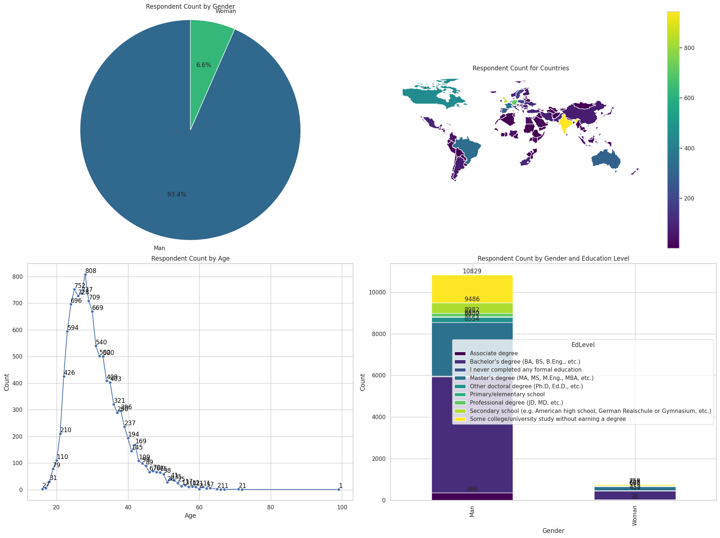
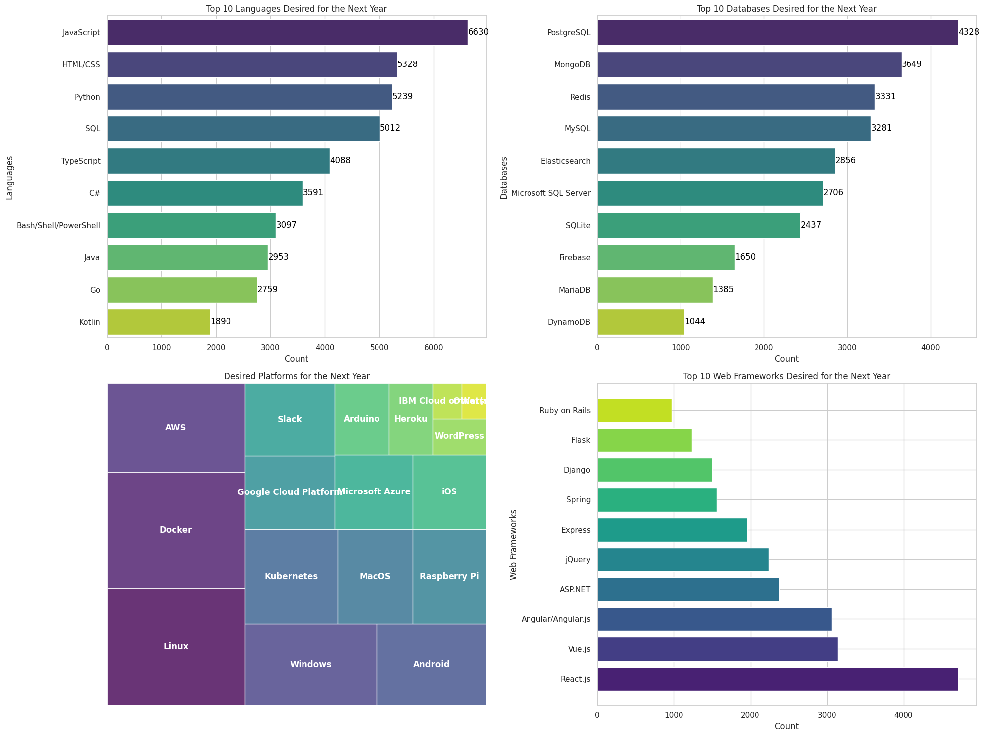
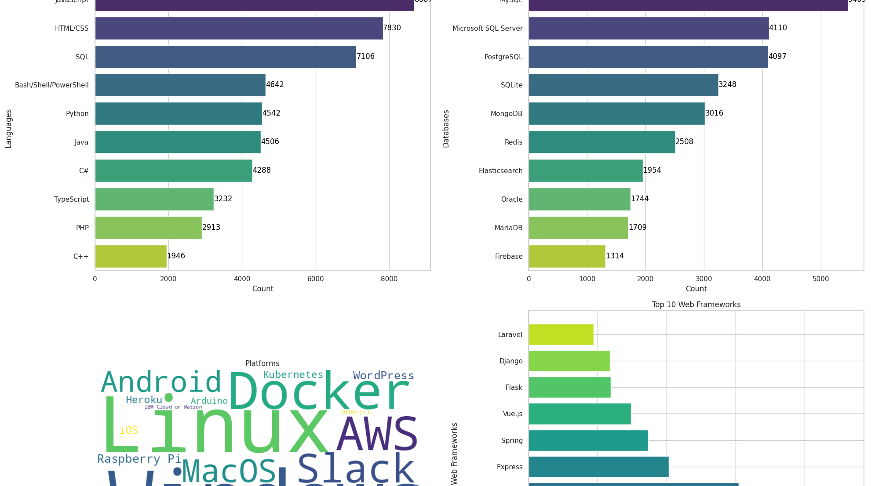
Cognos dashboard

Slide 12

Overall findings and implications
The analysis of current and future technology trends reveals that JavaScript, HTML/CSS, SQL, Python, and Java are the most widely used programming languages, with PostgreSQL, MongoDB, and Redis gaining traction for future use. Platforms like Linux, Docker, and Windows are prevalent, while AWS and Google Cloud Platform are highly desired. MySQL, Microsoft SQL Server, and PostgreSQL are the top databases, with a shift towards PostgreSQL, MongoDB, and Redis expected in the future. The demographic data shows a significant gender imbalance, with a younger, predominantly male respondent pool, and a high level of formal education among developers.
Implications: Developers should focus on enhancing their skills in JavaScript, Python, and PostgreSQL to stay competitive. Educational institutions should balance curricula between traditional databases like MySQL and emerging ones like MongoDB. Companies should adopt a hybrid database strategy to handle diverse data needs and invest in training for modern database technologies. The gender imbalance highlights the need for initiatives to encourage diversity in tech.

Slide 13
Conclusion
JavaScript and Python: Critical skills for developers, with enduring demand.
PostgreSQL and MongoDB: Increasingly popular databases, indicating a shift towards scalable, flexible solutions.
Diverse Platforms: Emphasis on cloud platforms like AWS and development environments like Docker and Linux.
Educational Focus: Need for a balanced approach to teaching both traditional and emerging technologies.
Diversity: Importance of addressing gender imbalances in the tech industry to foster inclusive growth.

